Slide 1
University Model Implementation

Slide 2
Hello!
We are -
FNU Maneesh - 001567281
Sushma Bhagya Nataraj – 002189655
Ishita Gandhi - 001541350

Slide 3
INTRODUCTION
It is very important for universities to be aware of the quality of education provided by them. For universities to maintain their standards, they should keep updating its educational policies and continuously introspect their methods of delivering skills to its students .
A performance measurement solution is created using software engineering techniques that enables universities to measure the quality of the education they deliver to their students.

Slide 4
OBJECTIVE
Improving existing course curriculum to posses the current industry trends.
Designing a digital system for data collection, visualization and improving the overall quality of education.
Gathering valuable feedback from alumni to improve the current course curriculum and to help the current students to attain desirable jobs.
Understanding from the alumni's what works and what doesn’t in the industry by tracking their progress over 5-year period.
Designing an approach that will look into how an educational system involving faculty, courses, and employers contribute to the professional growth.

Slide 5
Proposed Solution
Feedback
Tracking alumnis job performance
Understanding the industry requirements and modifying the existing curriculum to accommodate these requirements.
Investigating the relation between grades and job performances (Do grades matter ?)
Certifications that would bolster the students in landing their dream job .
Ranking existing courses to better understand the impact.

Slide 6


Slide 7
Feedback
For university to maintain its quality of education ,it becomes very essential to keep updating their teaching methods and curriculum. And to do that feedbacks forms are the best fit.
Feedback should be taken for the course and faculty.
Providing metrics regarding the feedback such as ranking courses based on popularity, course ratings etc.
This would enable universities to take actions based on the feedback

Slide 8


Slide 9
Tracking Alumnis
Tracking alumnis growth after graduating would help providing insights about which courses helped them in the long run.
Ideally it would be best to use LinkedIn’s developer Api’s to fetch the alumni details after graduating to get periodic updates.

Slide 10


Slide 11
University and Industry collabration
University is the best place for Employers to search for the right talent.
Using our system the employers could find the perfect candidate based on previous employees who were hired.
They have access to the relevant courses the students and Alumni's have taken, we could map them and give a list of similar profile's to the students they previously hired, in terms of course taken and grades obtained.
Industry could mention any certifications or skills needed for a specific role and that could be integrated in the curriculum by the university .

Slide 12


Slide 13
Do grades Matter?
To answer this question, we have a section on our dashboard.
We use the GCPA of the students who have graduated and map it with the salary they are currently getting.
We can group the CGPA's into groups and show the average salary in that CGPA range.
We can also have a page where we can enter a min and max CGPA and we can show them the salries people get in that CGPA range.
Looking at the output data we can answer the above question.

Slide 14


Slide 15
Certifications
The application can also enable the alumni's or the current students who managed to secure a job provide information to the universities such as weather the job they are currently pursuing was acquired by the certifications they gained during their studied or the university courses helped up.
This will give university a clear view of how do students manage to get jobs for themselves and what are the areas universities are suppose to work out.

Slide 16


Slide 17
Ranking
Ranking the courses would help the university understand which courses needed to be worked on.
Ranking the faculty would also help in getting insights on whether the course is bad, or the Faculty is bad.
We can the rank the courses based on popularity, course ratings etc.

Slide 18
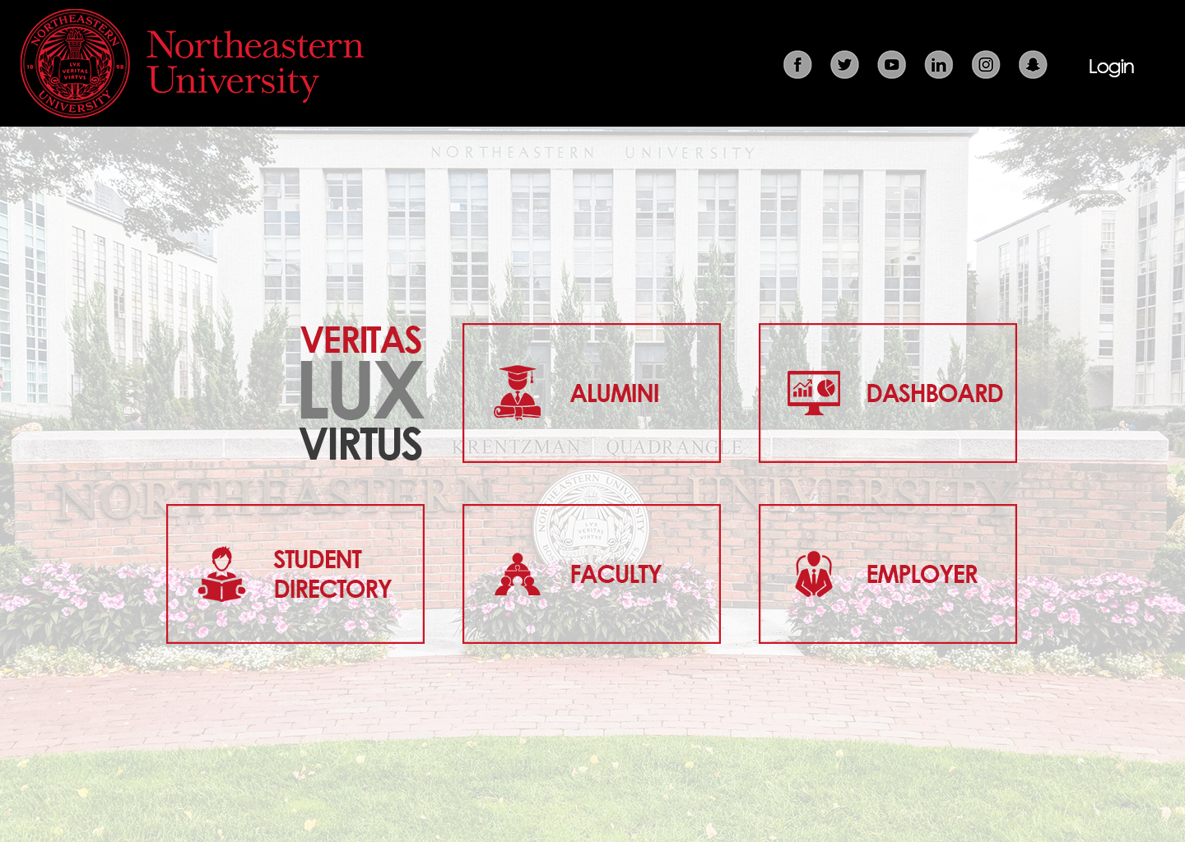

Slide 19
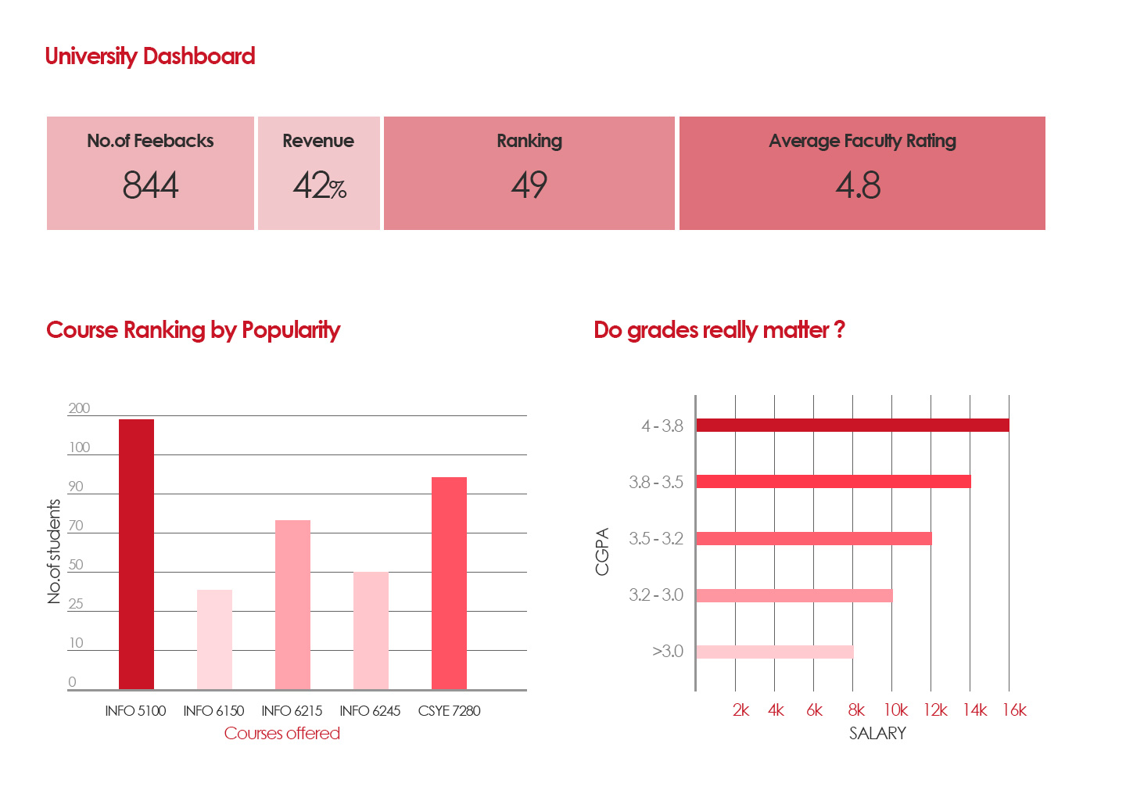

Slide 21
Implementation
Student Directory
Course Ranking by popularity
Course Ranking by feedback
Certifications done by Alumini based on a salary range
Domains that the certifications are done based on a salary range.
Do grades matter
Used Faker package for creating dummy data.

Slide 22
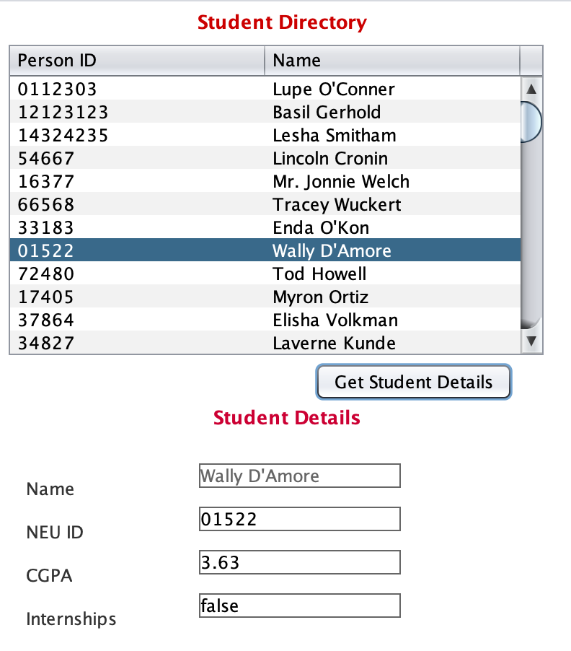
Student Directory
For admin to view the list of students and their details.

Slide 23
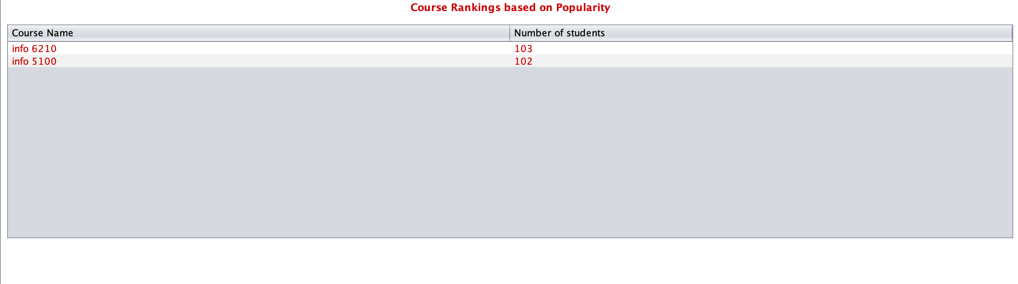
Course Ranking by Popularity
Ranking the courses based on number of occupied seats.

Slide 24
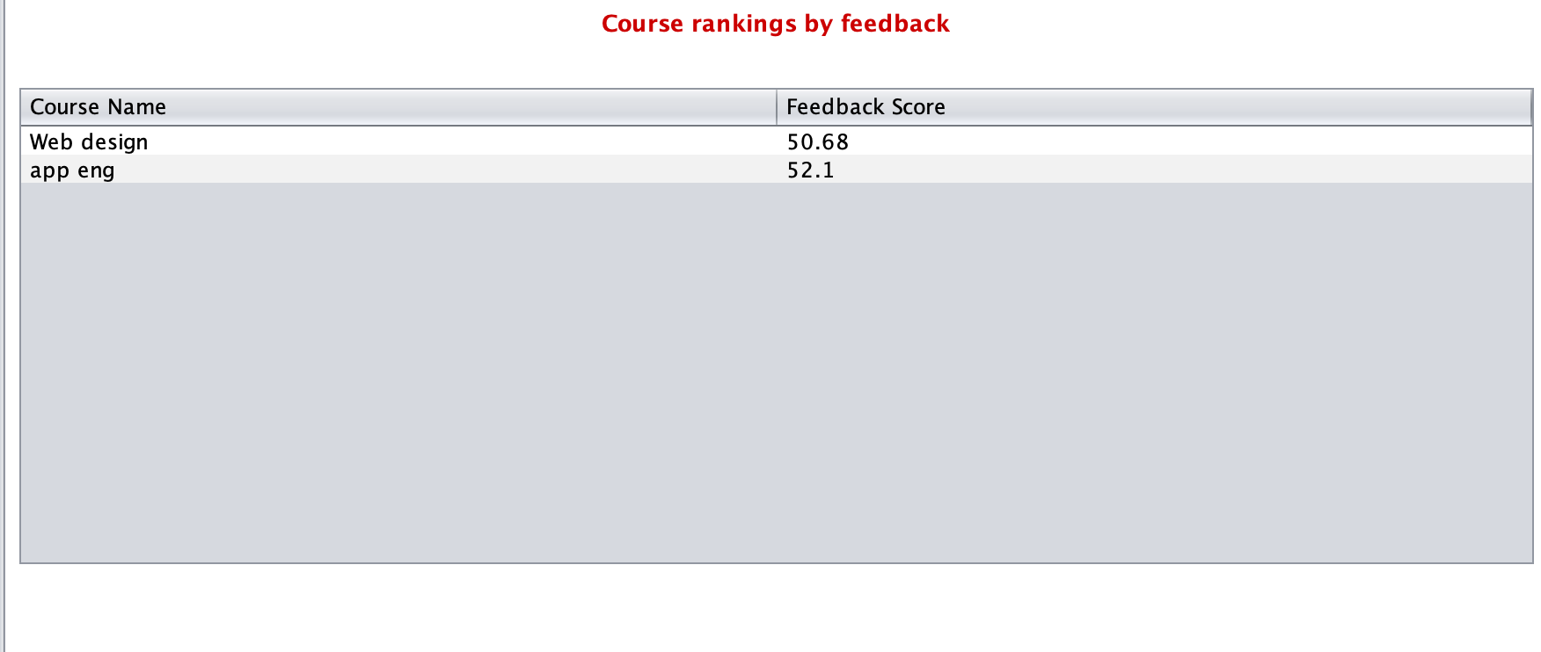
Course Ranking by Feedback
Ranking the courses based on student and Alumina Feedback

Slide 25
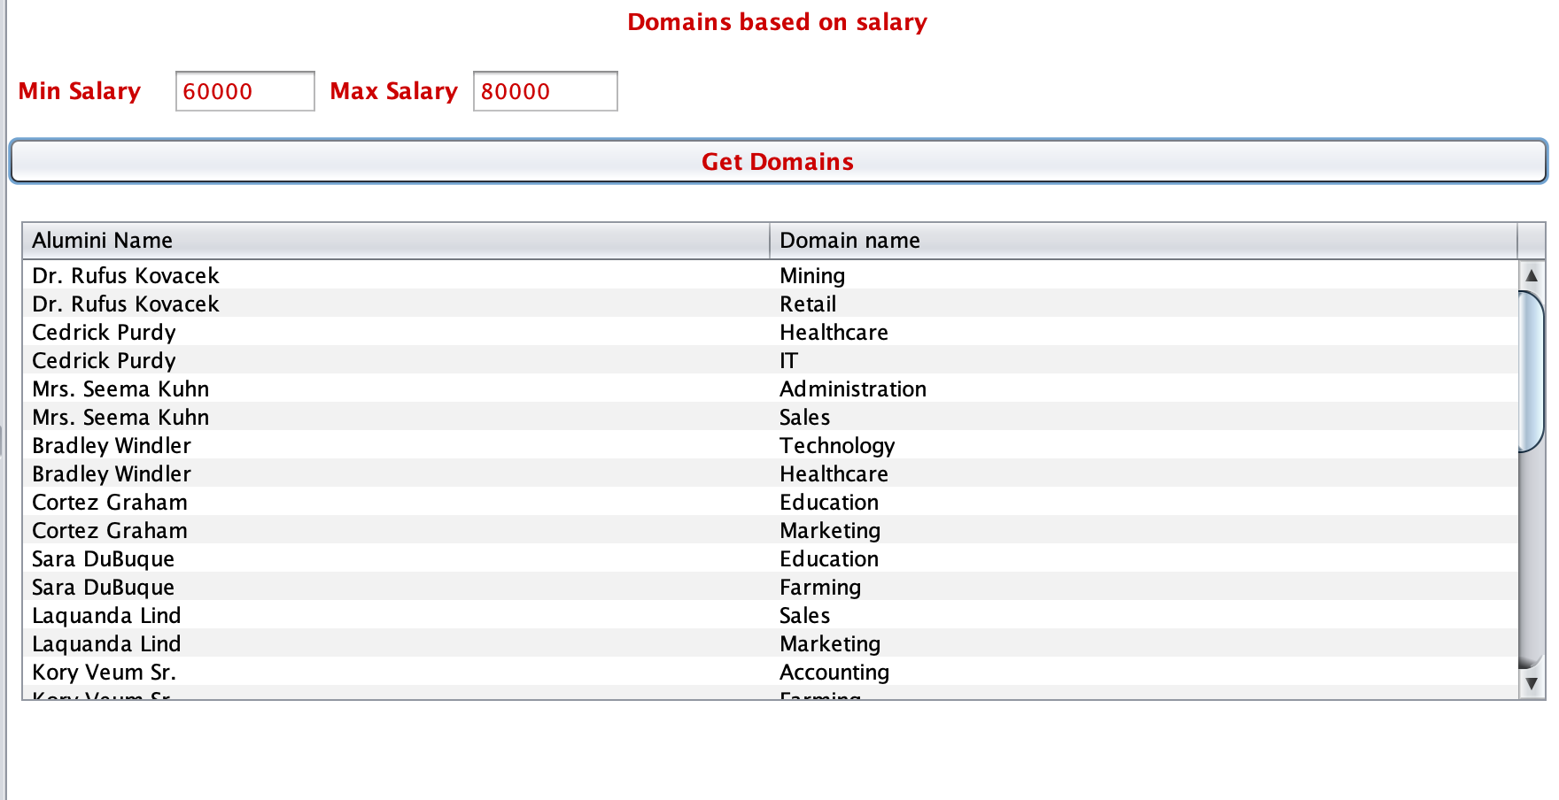
Domains based on Salary
Getting certifications done in a specific domain by people within the given salary range

Slide 26
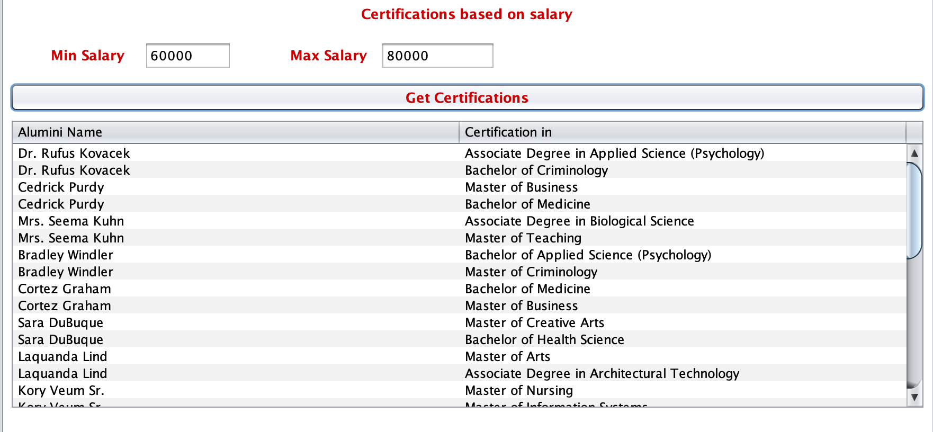
Certifications based on Salary
Getting certifications by people within the given salary range

Slide 27
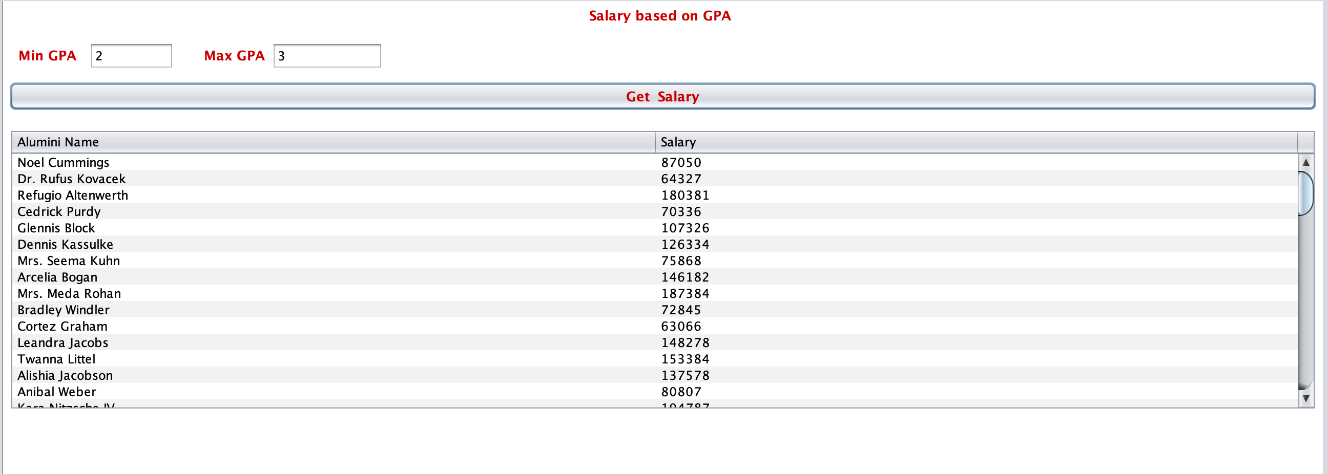
Do Grades Matter
Getting Salary's for alumina's within a given CGPA range

Slide 28
Solution for k-12 educational System
The Feedback forms can also be used in K-to-12 education system where students from higher classes can give feedback about their instructors so that instructors get to know the changes, they are supposed to make in their teaching methods
The same way K-to-12 education system can get information from their alumni students whether the university they have landed for their bachelors was because of the certifications they did other than school studies or just the school syllabus helped them to reach there.
At the end of the educational year in K-to-12 educational system students will be rating the courses they were taught an according the ratings the teachers can make changes in their curriculum for the upcoming batches.

Slide 29
Implementation to k-to-12 educational systems
Same implementation can be followed for K-to-12 education system where students are ranked according to their percentage and if a good number of students does not come in the range of good percentage ,through this instructors can analyze and work upon their teaching methods.
These same feedback forms can be implemented in K-to-12 education system where after the courses are ranked ,the one ranked in the lasts can be worked up by the schools for better output of the courses.
In K-to-12 education system the salary can be replaced by the type of university a student is admitted to in their bachelors. So, when a student sets the range of the university like ambitious or approachable or guaranteed, our implementation will provide him with the name of students in those universities and certifications they gained.

